Slide 1
Annual General Meeting and Conference 2024
John Kilcoyne
Deputy CEO
Leicestershire and Rutland Association of Local Councils

Slide 2
Climate Change – Steps Forward
John Kilcoyne
Deputy CEO
Leicestershire and Rutland Association of Local Councils

Slide 4
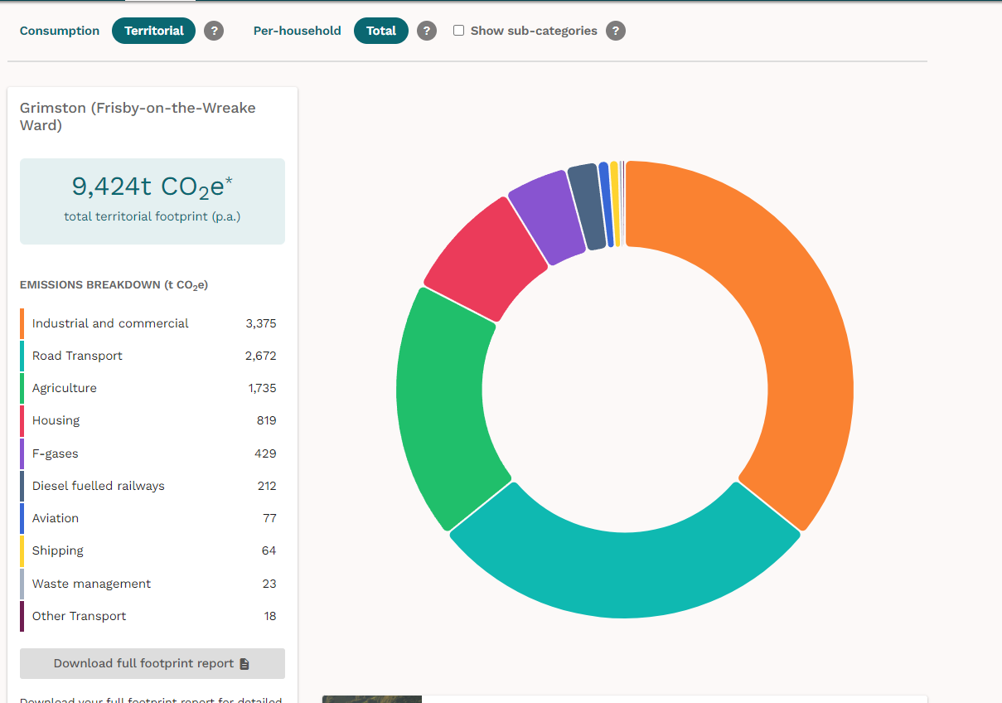
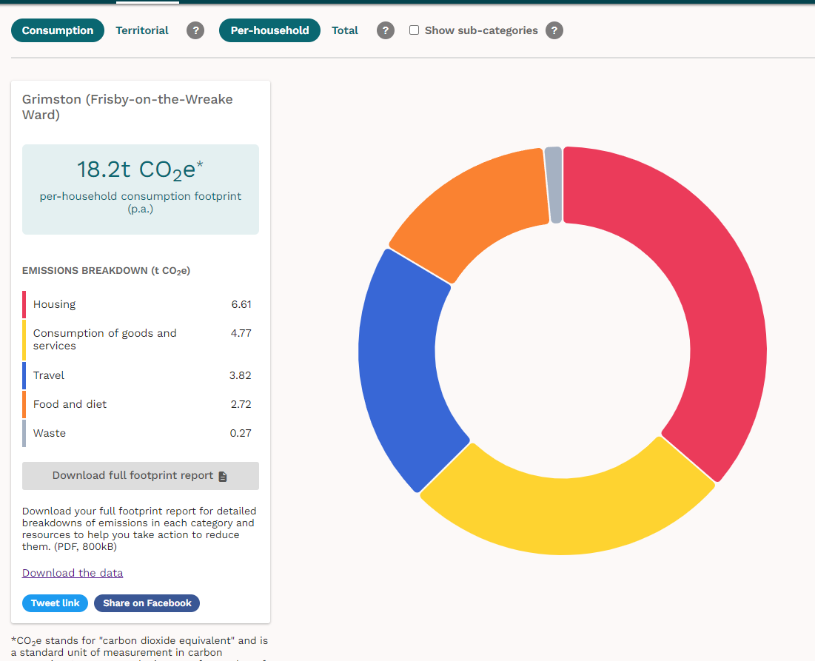
https://impact-tool.org.uk Data relates to Grimston, Saxelbye and Shoby Parish, April 2024
Population approx 240

Slide 5
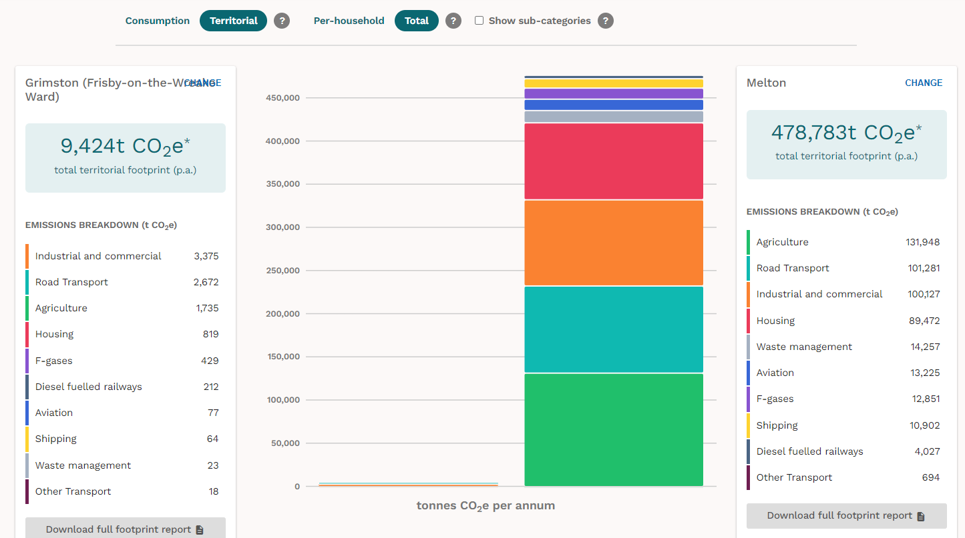

Slide 6
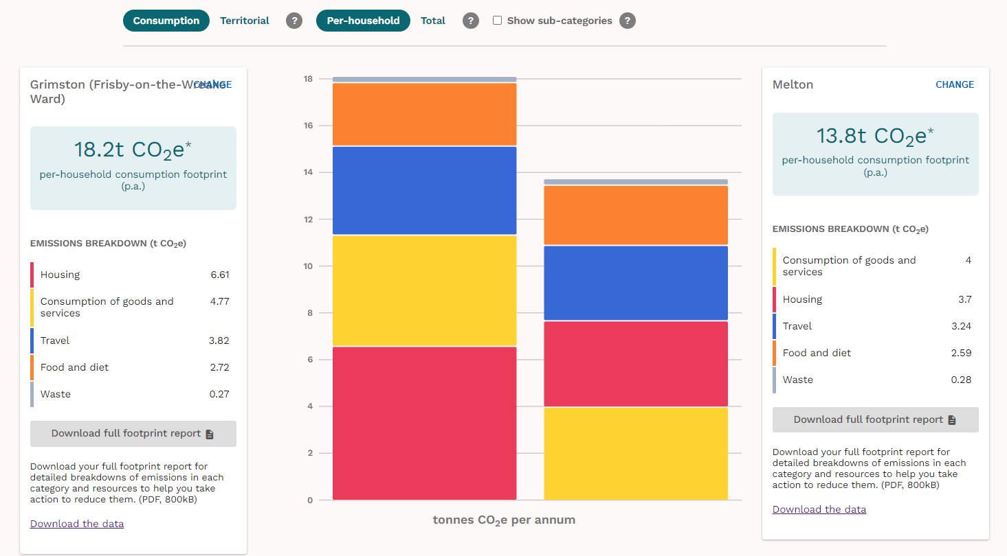

Slide 7
What can your Parish Council do?
Statutory responsibility and power:
Sustainable Energy and Climate Change Act 2006
Lead by example:
Audit your assets and resources – to come to in a moment
Declare a climate and biodiversity emergency – see next slide
Educate others
Enable practical action
Engage with local and neighbourhood planning
Share examples of good practice
Write a Sustainability Plan

Slide 8
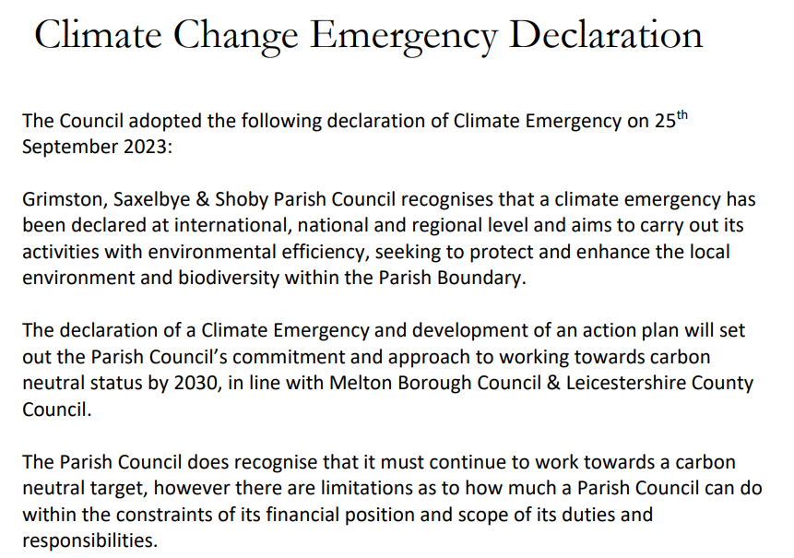
What can your Parish Council do?

Slide 9
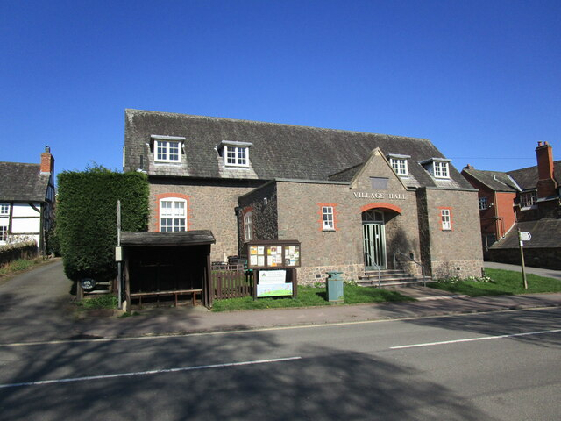
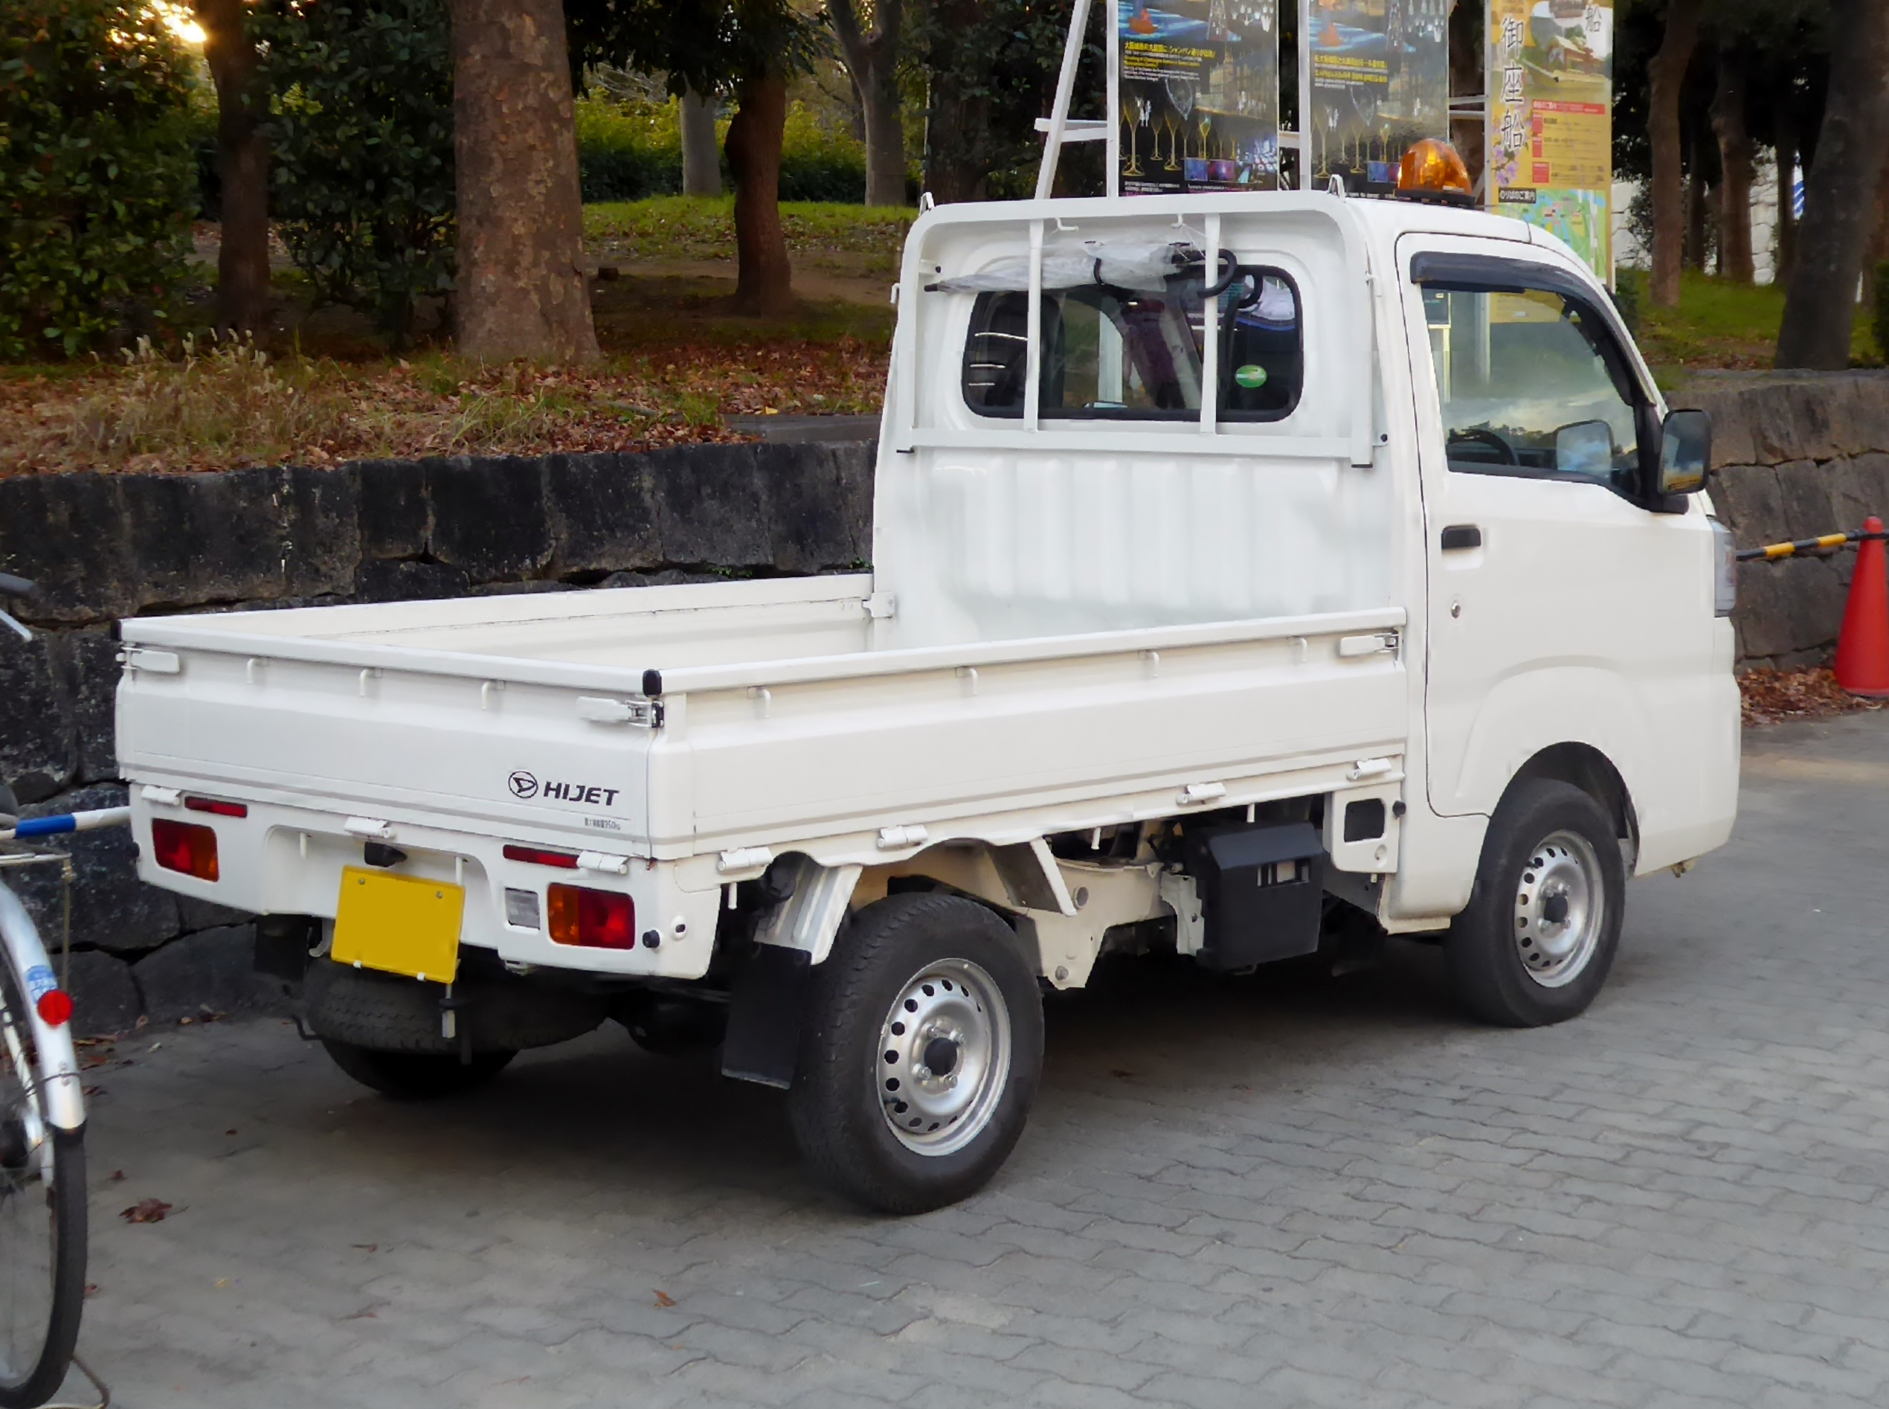
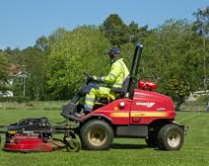
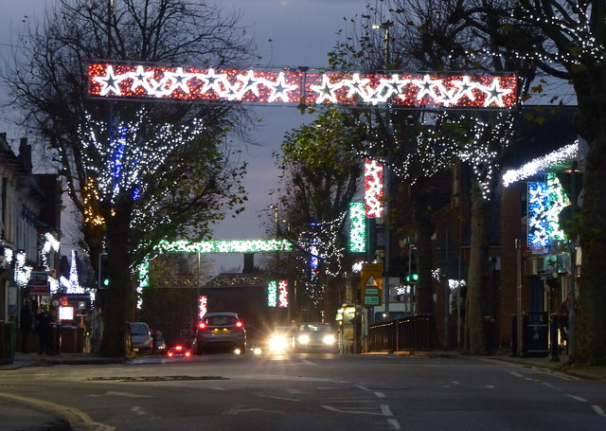
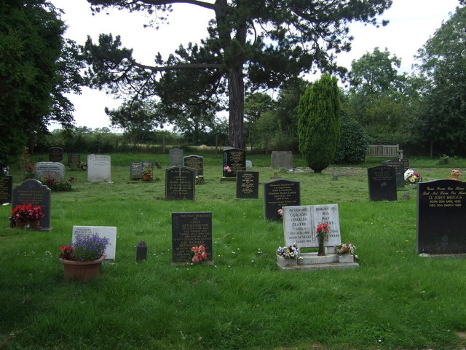
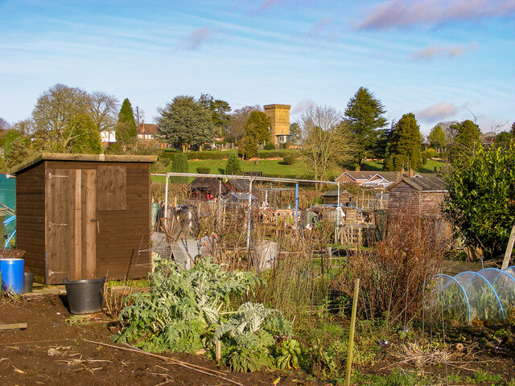
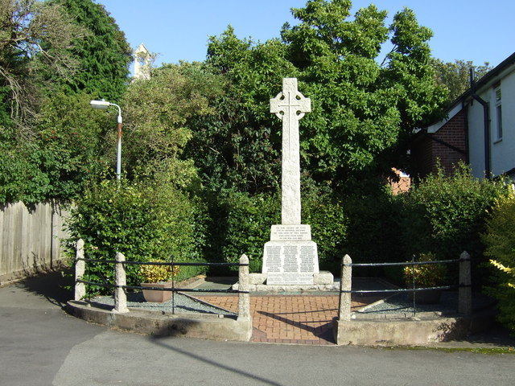
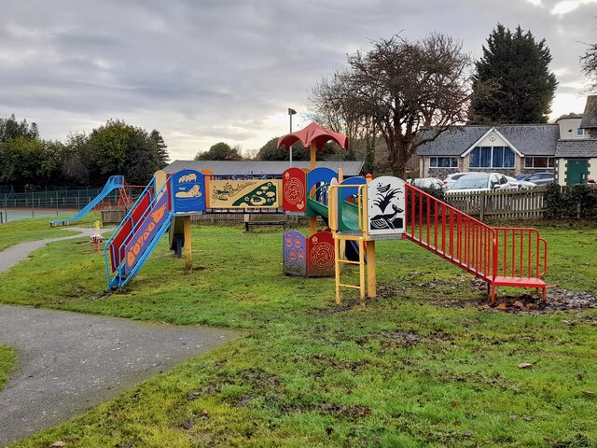
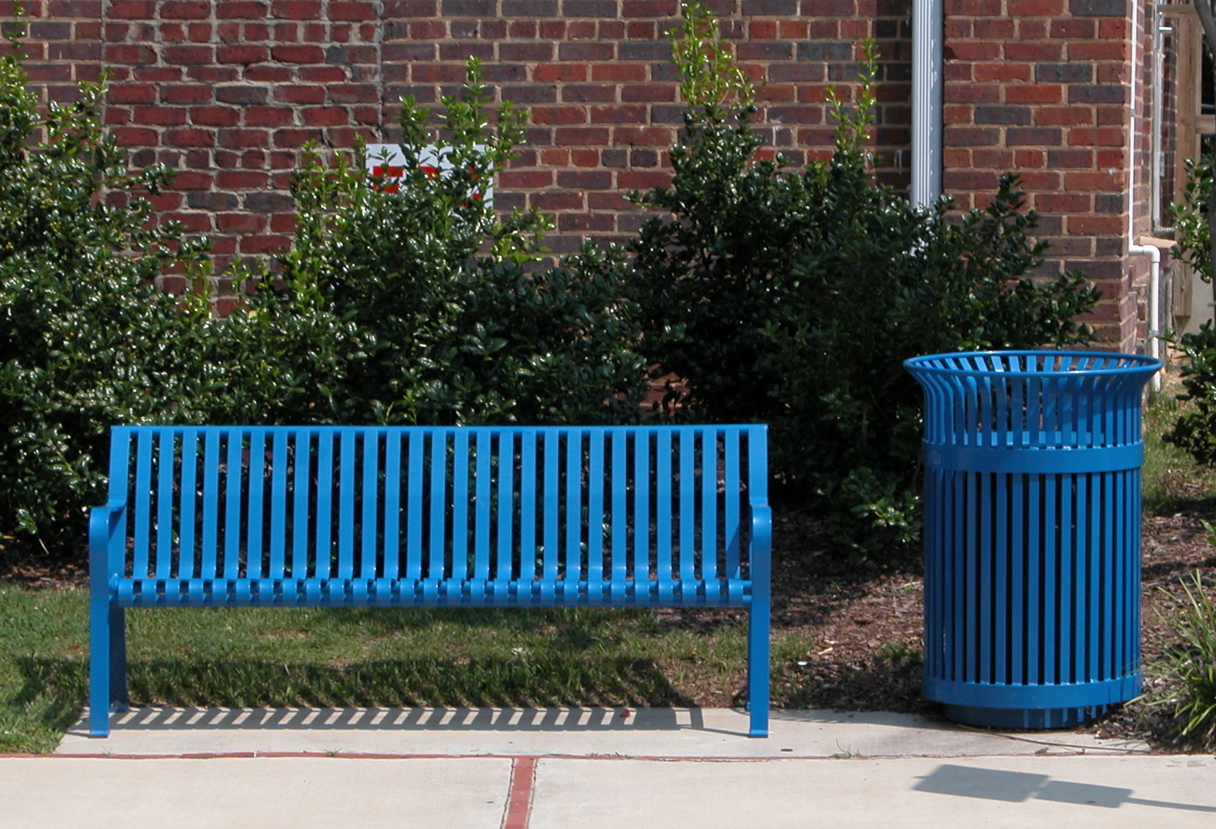
What does your Parish Council need to audit?
Think about every area of your business.
How do you use, fuel, maintain, repair, replace… ?

Slide 10
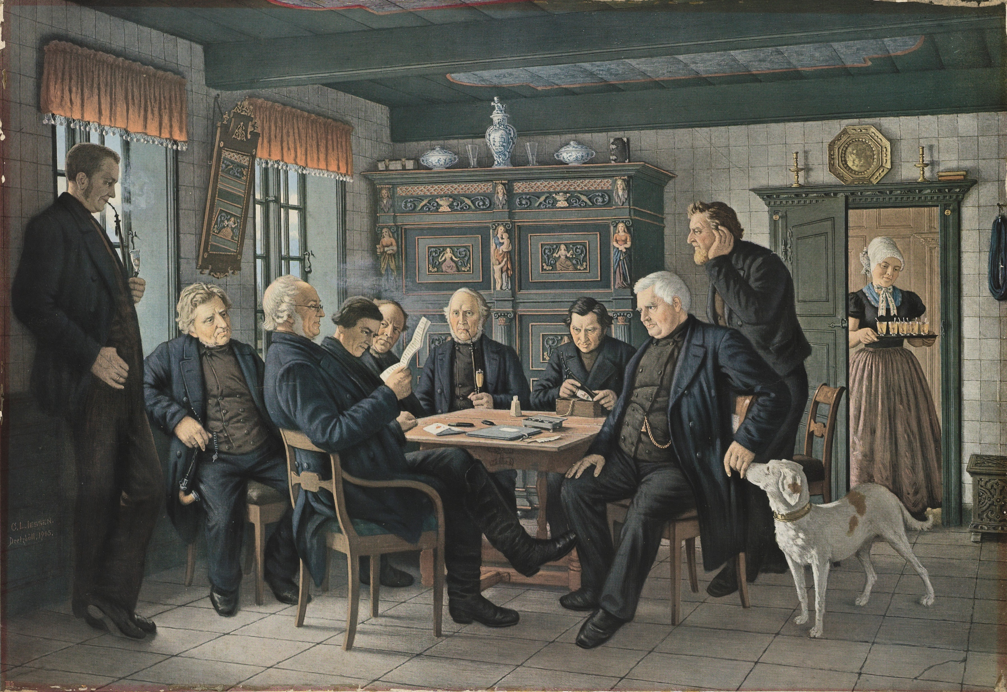
What does your Parish Council need to audit?
Even your council meetings have a carbon footprint!

Slide 11
What else can your Parish Council do?
Consider ethical banking
Encourage low-carbon ways of travelling
Engage with key stakeholders
Investigate bulk purchasing options
Manage land for nature
Motivate your community to get involved
Plant trees
Promote climate awareness
Reduce pesticide use
Support local and sustainable suppliers
…

Slide 12
What else can your Parish Council do?
Launched on 23rd September.
The scheme helps owners of public buildings to achieve net zero and switch to cleaner energy and can fund things like new insulation, double glazing and low-carbon heating.
The scheme is run by the Department for Energy Security and Net Zero, is delivered by Salix Finance.
www.salixfinance.co.uk/schemes/phase-4-public-sector-decarbonisation-scheme

Slide 13
Where can I find out more?

Slide 14
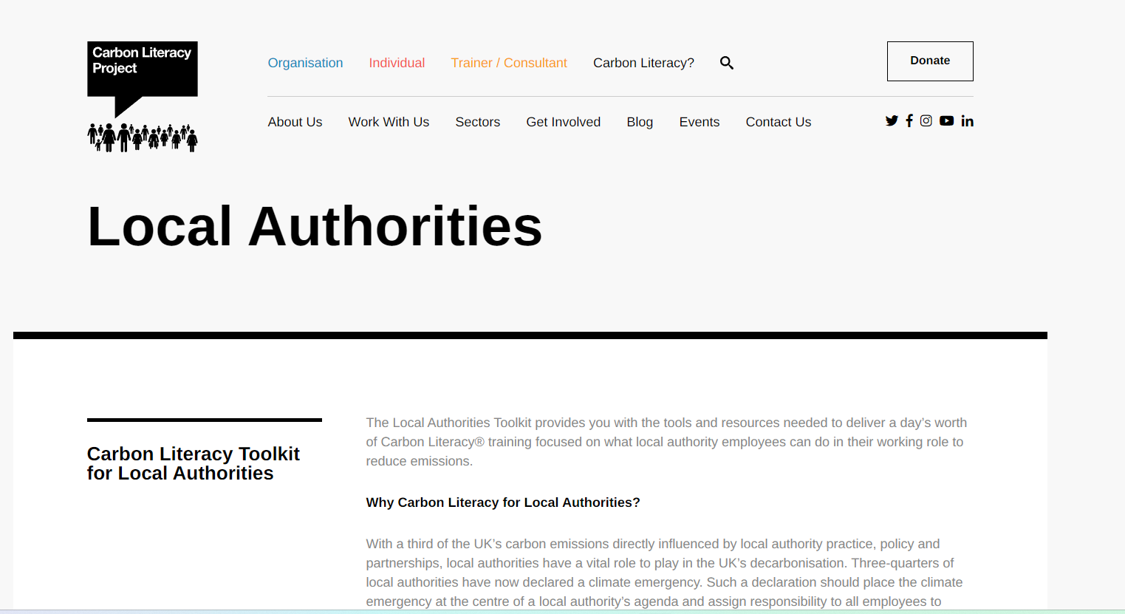
https://carbonliteracy.com/local-authorities/

Slide 15
https://www.leicestershirecommunities.org.uk/parish-councils/net-zero-toolkit

Slide 16
www.leicestershirecommunities.org.uk/parish-councils/net-zero-toolkit
www.leicestershireandrutlandalc.gov.uk/climate-change
www.leicestershire.gov.uk/environment-and-planning
www.rutland.gov.uk/rutland-information-service/directory/4gbp1uki4n0

Slide 17
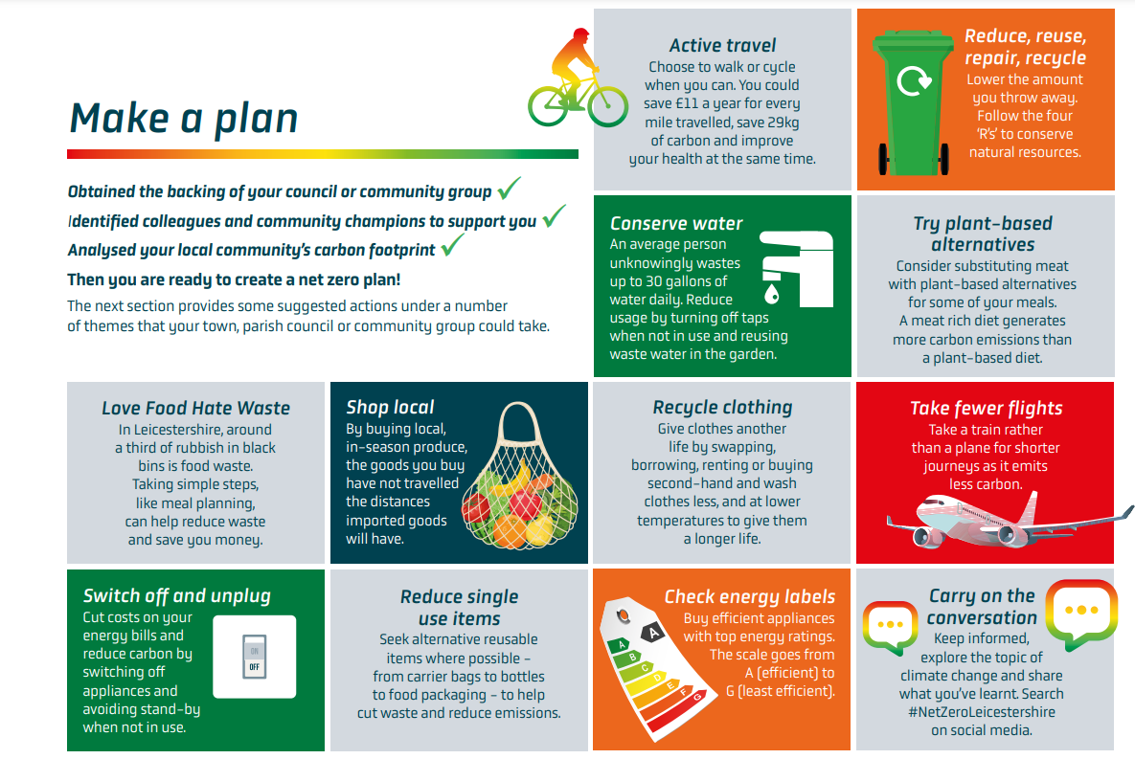

Slide 18
How can LRALC help your council?
Blaby DC pilot project, Autumn 2023
Worked with 4 parish councils
No cost to these parish councils – funded by Blaby DC
Audited every aspect of council business with the clerk – assets, buildings, vehicles, equipment, meetings etc
Written report with recommendations
Access to energy specialists to review council use and contracts
Carbon Literacy Training for up to 4 participants per council
Ongoing monitoring and requests for feedback from LRALC

Slide 19
How can LRALC help your council?
Now opening up to other councils across the whole LRALC area
Carbon footprint audit
We will audit every aspect of council business with your clerk
Provide a written report with recommendations
Give access to energy specialists to review council use and contracts
Arrange Carbon Literacy Training from specialists

Slide 20
How can LRALC help your council?
Now opening up to other councils across the whole LRALC area
Carbon footprint audit
Time and cost? The time involved will vary according to council
Most councils could be visited with all aspects of council business audited within a single morning
Add on another couple of hours for LRALC for the written report
We’d aim to complete an audit within 5 hours @£60 per hour plus travelling costs, but we’d have to keep this flexible

Slide 21
How can LRALC help your council?
Now opening up to other councils across the whole LRALC area
Carbon footprint audit
Carbon Literacy Training
Additional cost to council, not included in an audit
Provided by an accredited third party organisation, not LRALC
Can be added to an audit or accessed separately
Currently £120 per person
8 hours of remote training across 2 mornings, usually a week apart
Involves a personal assessment including individual and council targets
LRALC will arrange courses when enough participants make this viable
LRALC will take no income from this, training and assessment fees will go to the provider and Carbon Literacy Project

Slide 22
How can LRALC help your council?
Now opening up to other councils across the whole LRALC area
Carbon footprint audit
LRALC do not make any claims to be climate change experts
However, we are experts in parish councils and know about your business

Slide 23
How can LRALC help your council?
Now opening up to other councils across the whole LRALC area
Carbon footprint audit
Interested?
Contact our office

Slide 26
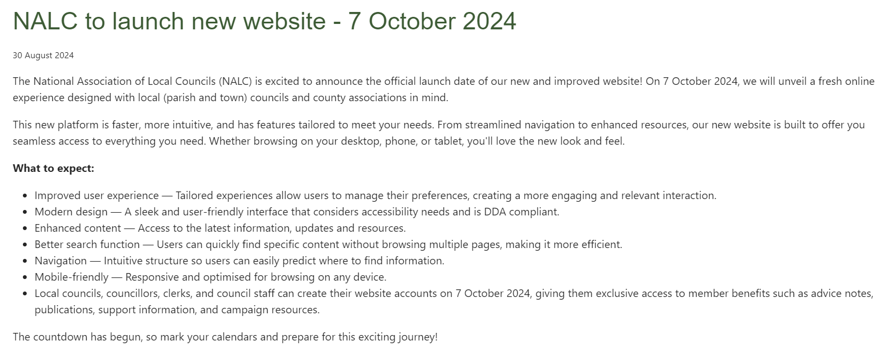
New website launched 7th October
www.nalc.gov.uk

Slide 27
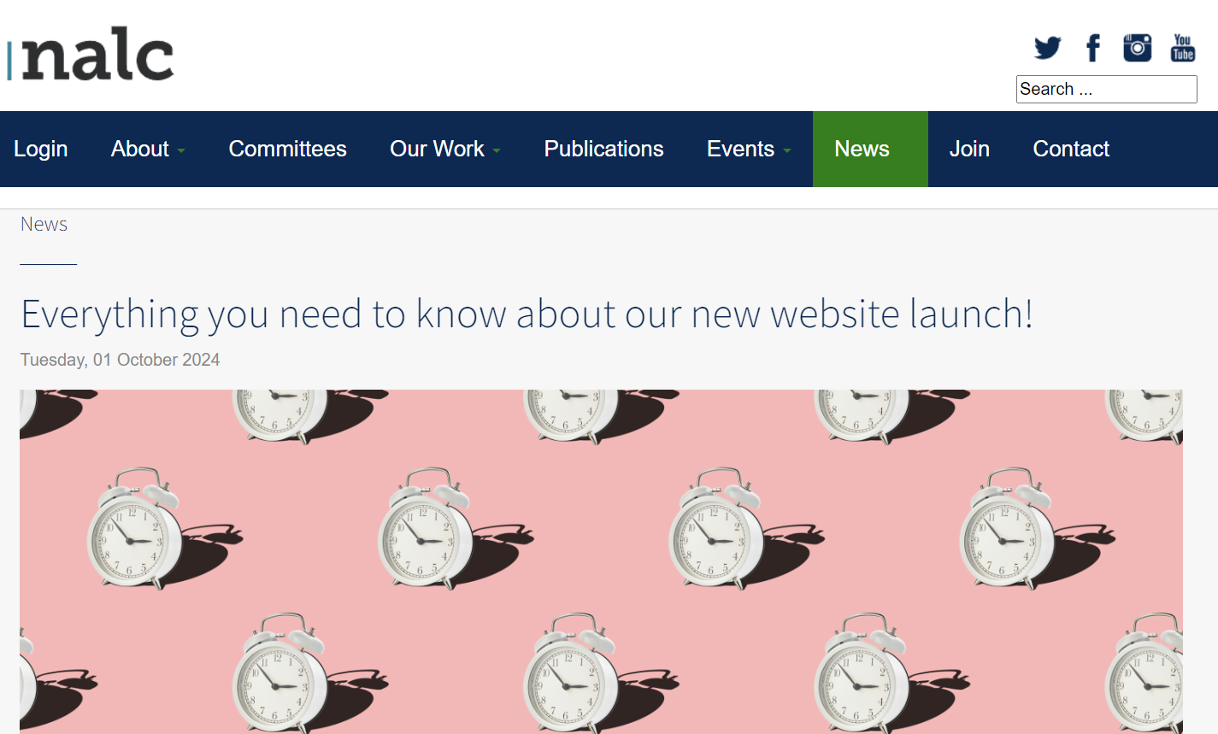

Slide 28
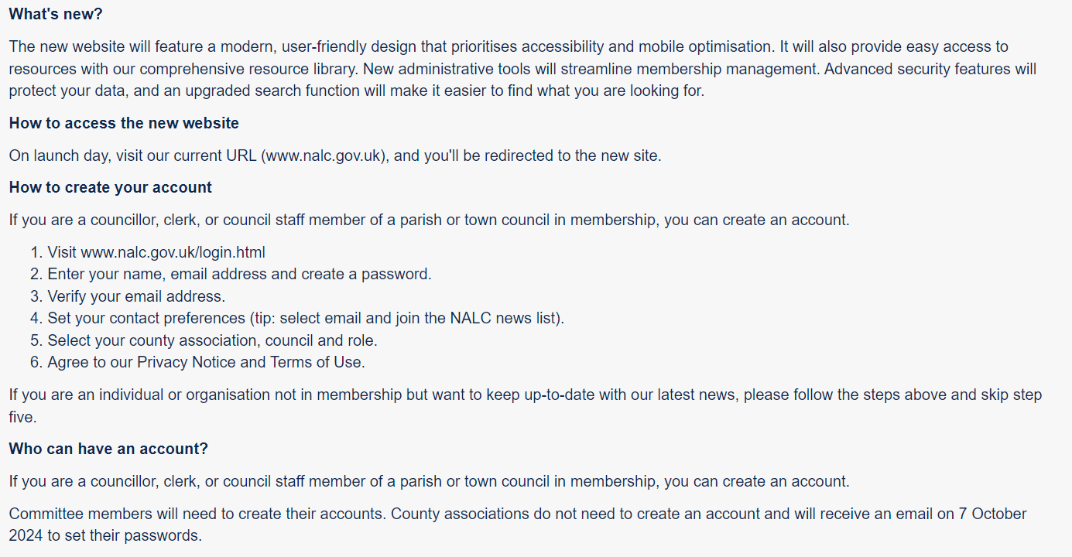

Slide 29
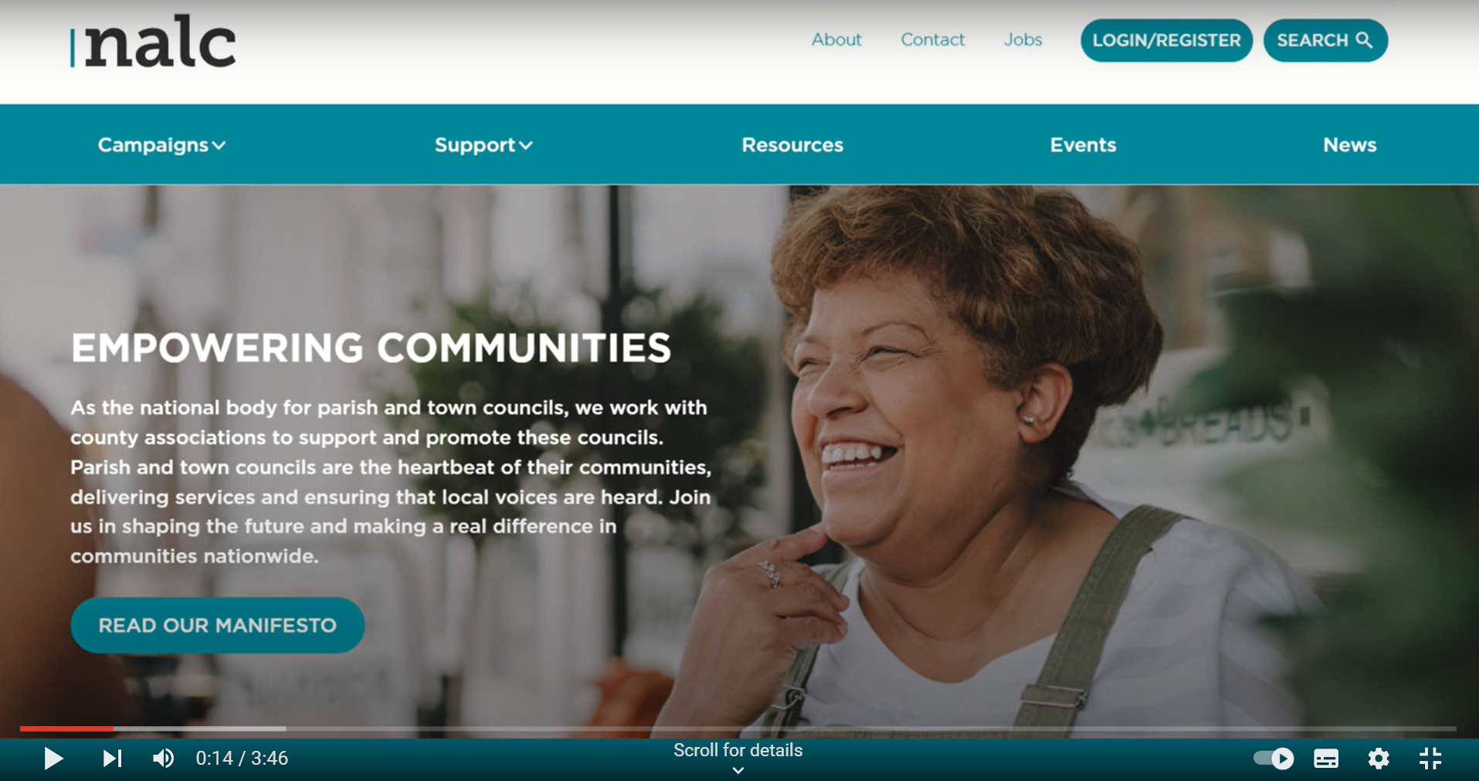

Slide 32
Changes 2024
New criteria and application form October
First briefing from NALC
www.nalc.gov.uk/our-events/upcoming-events/eventdetail/402/-/local-council-award-scheme-introducing-the-new-criteria

Slide 33
Why apply?
To recognise high standards
To set a framework for improvement
To show confidence in your policies and practices
To celebrate your commitment and hard work
To show your community that you are an award-winning council

Slide 34
LRALC free support to resume early 2025
General LCAS briefings every few months
Direct support to councils considering an application
to identify the best evidence to meet the criteria
to maximise the chance of early success
to present the application to meet the needs of assessors

Slide 35
Current LRALC award-holding councils
Birstall Parish Council (September 2024)
Blaby Parish Council
Leicester Forest East Parish Council
Lutterworth Town Council (September 2024)
Syston Town Council
Waltham on the Wolds and Thorpe Arnold Parish Council

Slide 36
Current LRALC award-holding councils
Ashby Town Council

Slide 38
.gov.uk domain
Why?
Practitioners’ Guide:
1.26: "every authority should have an email account that belongs to the council and to which the council has access."
5.213: "community, suppliers and partners will now reasonably expect a local council to have a .gov.uk domain".

Slide 39
.gov.uk domain
Why?
Using a .gov.uk domain for council business, emails, and website is a sign of good practice, trust and professionalism
Source: NALC Blog, 8th May 2024

Slide 40
Local councils with a .gov.uk domain can benefit from:
Robust security measures and monitoring for cyber vulnerabilities by the Cabinet Office
Emails that are immediately recognisable as legitimate and trustworthy by the recipient
Separation of personal and professional communications. Recipients will always understand the capacity in which the email is sent
Administrative control over email accounts for easy management of change (new joiners, leavers, sudden absences) and Freedom of Information and Subject Access Requests
Peace of mind that the council's .gov.uk domain will never be sold to another organisation should it not be renewed on time
Source: NALC Blog, 8th May 2024

Slide 41
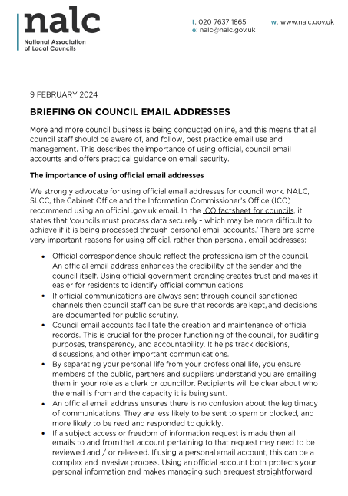

Slide 42
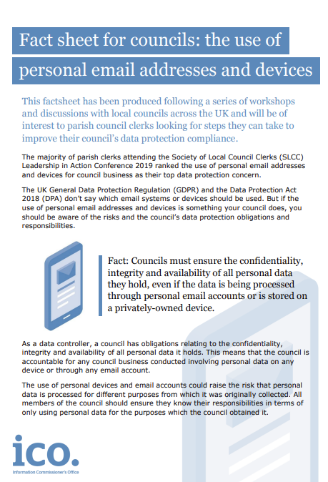

Slide 43
Parish Council Domains Helper Service
Tailored support is available at every step of the process
Virtual sessions are accompanied by guides containing checklists, templates, and detailed, practical information
Access to up to £100 to support your transition
The money for this support is limited and will cease in February 2025

Slide 44
Parish Council Domains Helper Service
*Source: Parish Council Domains Helper Service, 1st October 2024
Councils in Leicestershire and Rutland | 197
Councils engaging with Parish Council Domains Helper Service since March 2024* | 62
Councils with .gov.uk addresses (October 2024)* | 48

Slide 45
Current situation with councils with .gov.uk addresses*
( includes councils who have had these prior to PCDHS support)
Blaby District Council | 9 | 37.5%
Charnwood Borough Council | 8 | 29.6%
Harborough District Council | 12 | 27.3%
Hinckley and Bosworth Borough Council | 7 | 29.2%
Melton Borough Council | 5 | 15.6%
North West Leicestershire District Council | 7 | 28%
Rutland County Council | 3 | 10%
Total | 48 | 24.4%
*Source: Parish Council Domains Helper Service, 1st October 2024

Slide 46
Parish Council Domains Helper Service
How to find out more?
Complete the short form to express an interest or contact parish-helper@domains.gov.uk
Link available from NALC Blog, 8th May

Slide 47
Parish Council Domains Helper Service
Tailored briefings for LRALC member councils
Book via LRALC website
Tuesday 29th October | 5-6pm | Councillors
Wednesday 30th October | 1:30-2:30pm | Clerks

