Slide 1
LRALC 2024 AGM & CONFERENCE
Have you visited the marketplace yet?

Slide 2
LRALC Conference & AGM 5th October 2024
Vice Chairman & AGM Chair
Geoff Hulland

Slide 3
LRALC Conference & AGM 5th October 2024
Jake Atkinson John Kilcoyne
Chief Executive Deputy Chief Executive

Slide 4
Sector support in 2024

Slide 5
What is LRALC’s job?
To be experts in all matters parish/town council related

Slide 7
Sector update, including future LRALC priorities & new services being considered by your Association
Member satisfaction survey and priority setting
Current national & local activity lobbying the new government, and newly (re)elected MPs.
The Civility and Respect project and online resources.
The brand new NALC website.
Operational liaison with your local borough/district/county councils, and other partners/stakeholders.
Getting maximum benefit from your LRALC & NALC membership – don’t’ suffer in silence.

Slide 8
Parish Liaison Meetings
DISTRICT/BOROUGH | TYPE OF MEETING | DATE
Blaby | Clerks Operational Meeting | 27th November 2024
Charnwood | Parish Liaison Meeting | 18th March 2025 (TBC)
Harborough | Clerks Operational Meeting | 9th October 2024
Hinckley & Bosworth | Parish Forum | 28th November 2024
Melton
North West Leics | Parish Liaison Meeting | 3rd December 2024
Rutland | Parish Liaison Meeting | 6th November 2024
Rutland | Clerks Operational Meeting | 27th November 2024
Rutland | Parish Liaison Meeting | 29th January 2025

Slide 10
Q&A – Your opportunity to discuss and/or raise issues of importance with LRALC officers and directors.

Slide 12
LRALC 2024 AGM & CONFERENCE
Have you visited the marketplace yet?

Slide 13
LRALC AGM 2024 Agenda

Slide 14
Prize Draw
Vice Chairman & AGM Chair
Geoff Hulland

Slide 15
Plenary 2 Plenary 2 “Your Councils – What Will Your Priorities Be”
Vice Chairman & AGM Chair
Geoff Hulland

Slide 16
Hot Topics for Parish and Town Councils
Carbon Net Zero
Local Council Award Scheme (LCAS)
Moving to a gov.uk domain
Consultation and community engagement
Capital projects (community buildings, etc)
Devolved services
Precepting for the coming year

Slide 17
Budget Setting Autumn 2024
Forthcoming budget process will be challenging.
ALL councils regardless of size need to take the impact of inflation in to account.
Three opposing options – increase precept, cut activity, or draw on reserves.
Is what you do locally important?
Crisis may last longer still (middle east, etc) – longer term view needed.
Is cutting back going to deliver any meaningful savings for people?

Slide 18
Example of adding 10% (£33,754) to precept
2022-23 | 2023-24
£337,548 precept Tax base 2676.5 Council Tax = £126.12 | £371,302 precept Tax base 2676.5 Council Tax = £138.72 Costs a household £1 a month

Slide 19
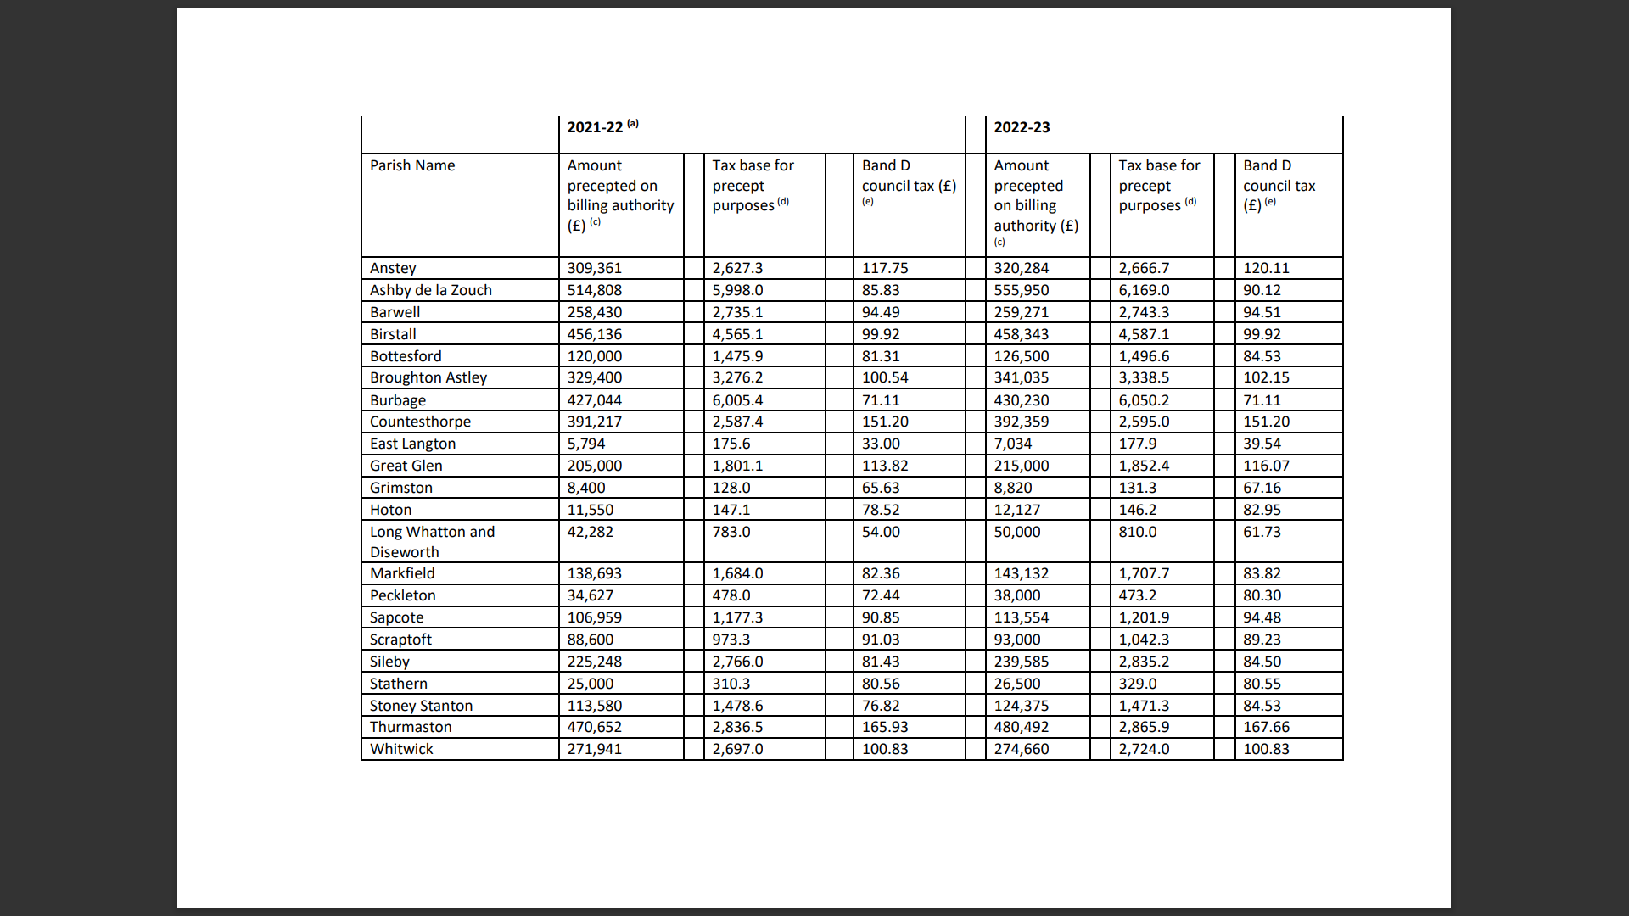

Slide 21
Planning for the Medium Term
Do you have formally agreed priorities?
If you do have priorities how did you set them and what involvement did your electors have in the setting of these?
How do you know if parishioners want you to do more?
If you don’t want to do more and your parishioners do what are you going to do about it?
Are you focussing on “improving the life of residents” or are you just maintaining the status quo?

Slide 22
Quality Level:
“The action plan (or similar forward plan) summarises findings from community engagement and sets out aims and objectives that respond to community views”.
“The action plan includes a timetable for actions to be completed with dates for reviewing the plan. The council’s budget shows how the action plan is put into practice”.

Slide 23
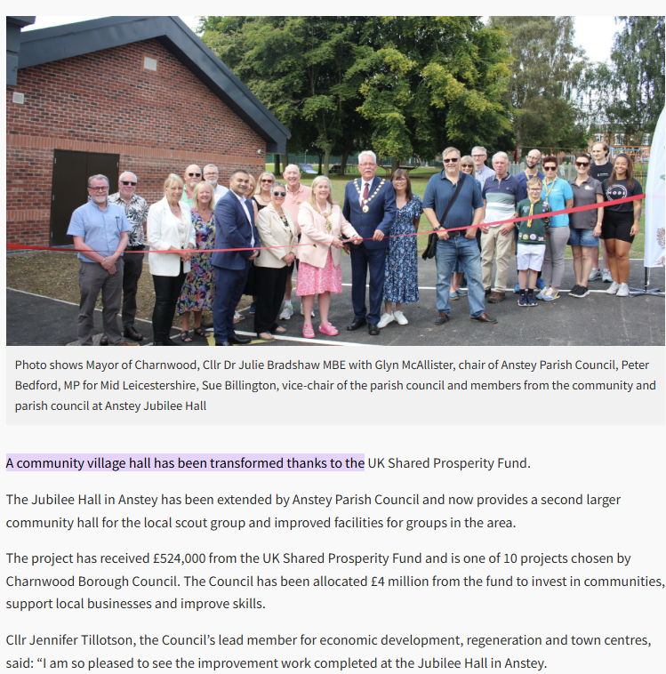
Anstey Parish Council’s Rebuild of Jubilee Hall.
Part funded by the UK Shared Prosperity Fund.

Slide 24
Community Consultation & Engagement
Helps ensure aims and objectives recognise community views
Informs parishioners where their money is going, and how much.
Avoids statements of opinion being presented as fact………..
Council meetings are not a form of consultation and engagement!
Be creative - Vox pop, stalls at community events, coin voting, being at shops, using annual parish meeting, participatory budgeting, etc
Professional research (especially for large high risk projects)
Don’t forget stakeholders and partners
See NALC and LCC toolkits for further guidance and ideas

Slide 25
Support available from LRALC
Job evaluations
Strategic Planning facilitation
Recruitment and Selection support
In-house training
Specialist training : Procurement, VAT, Finance for Councillors, etc.
HR advice
Legal advice

Slide 26
Questions?

